Slide 1
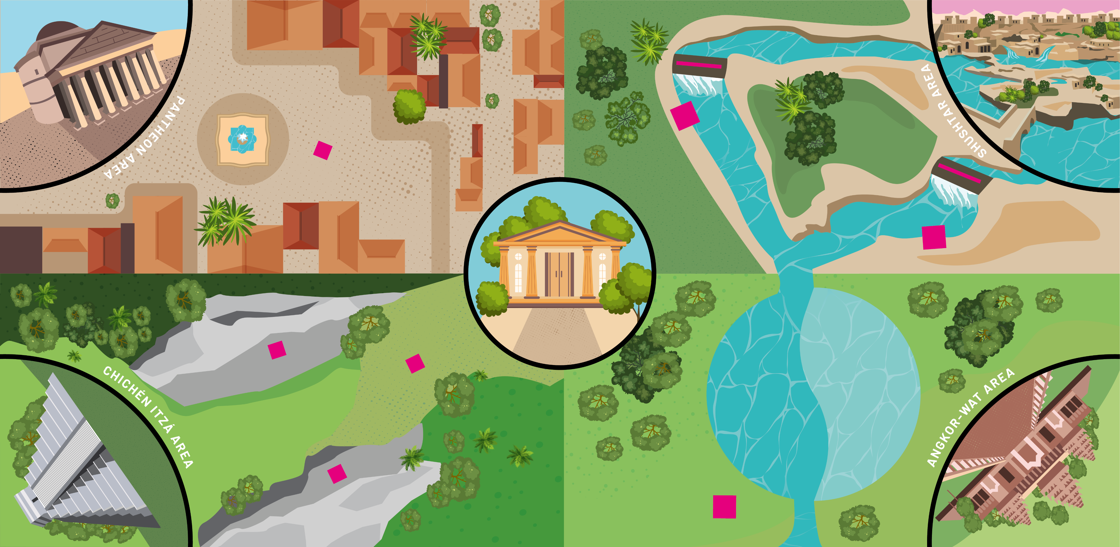
Museum area
Pantheon corner
Gates
Mills
Shushtar corner
Column
Chichén Itzá corner
Randomizer
Angkor Wat corner
Ball game goals
Trophy
Lake

Slide 2
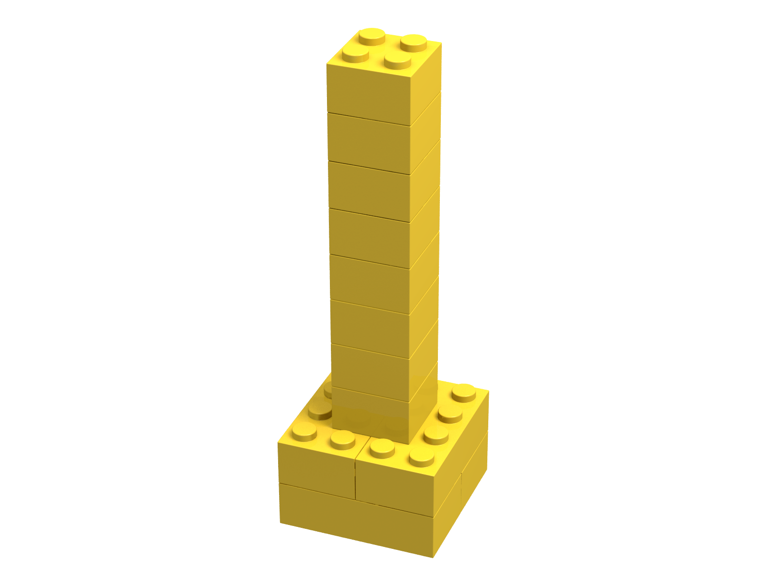
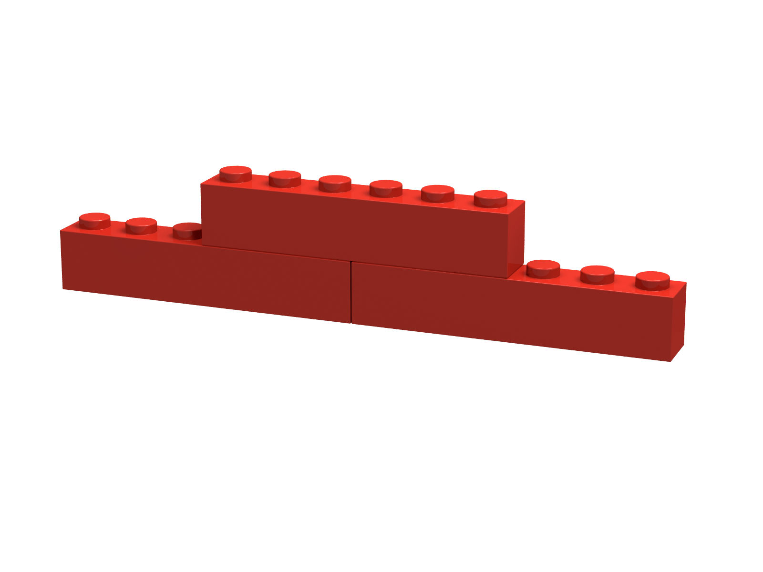
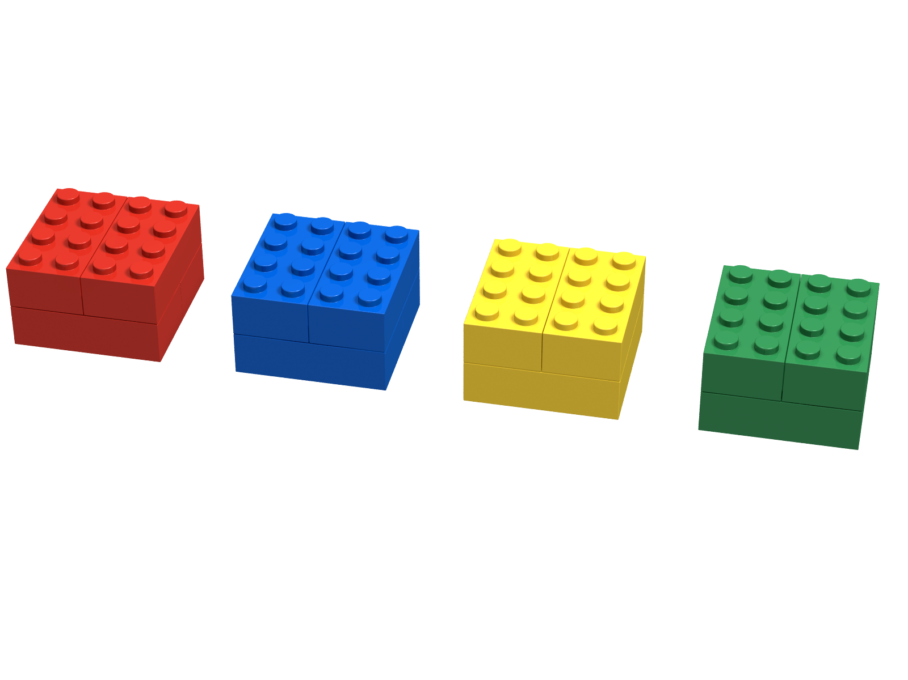
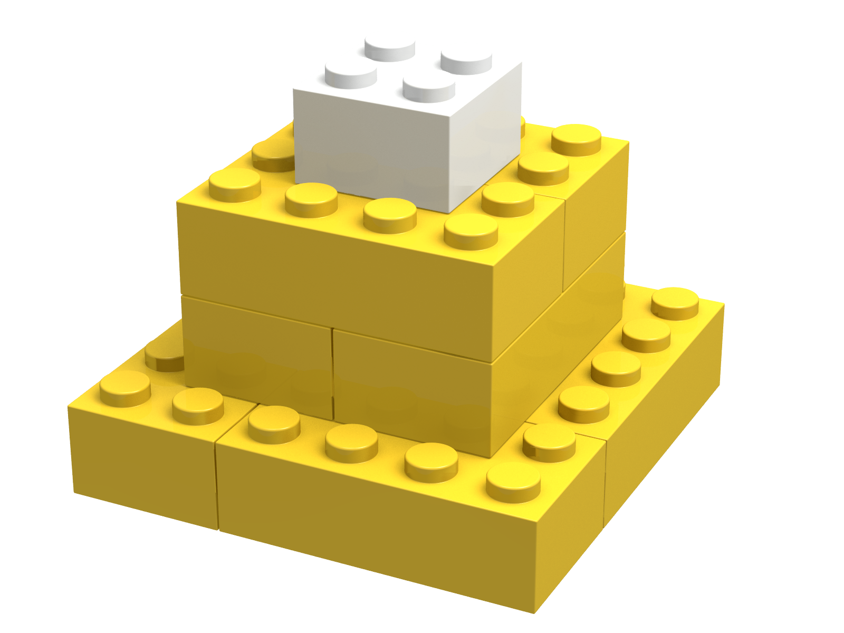
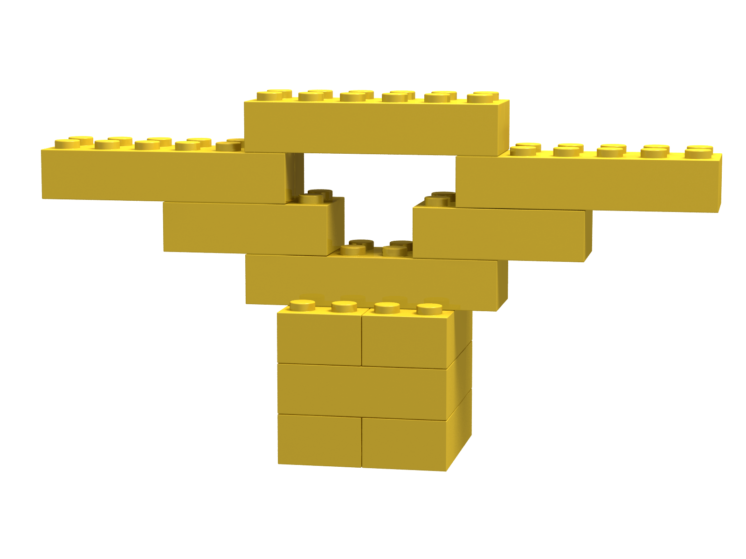
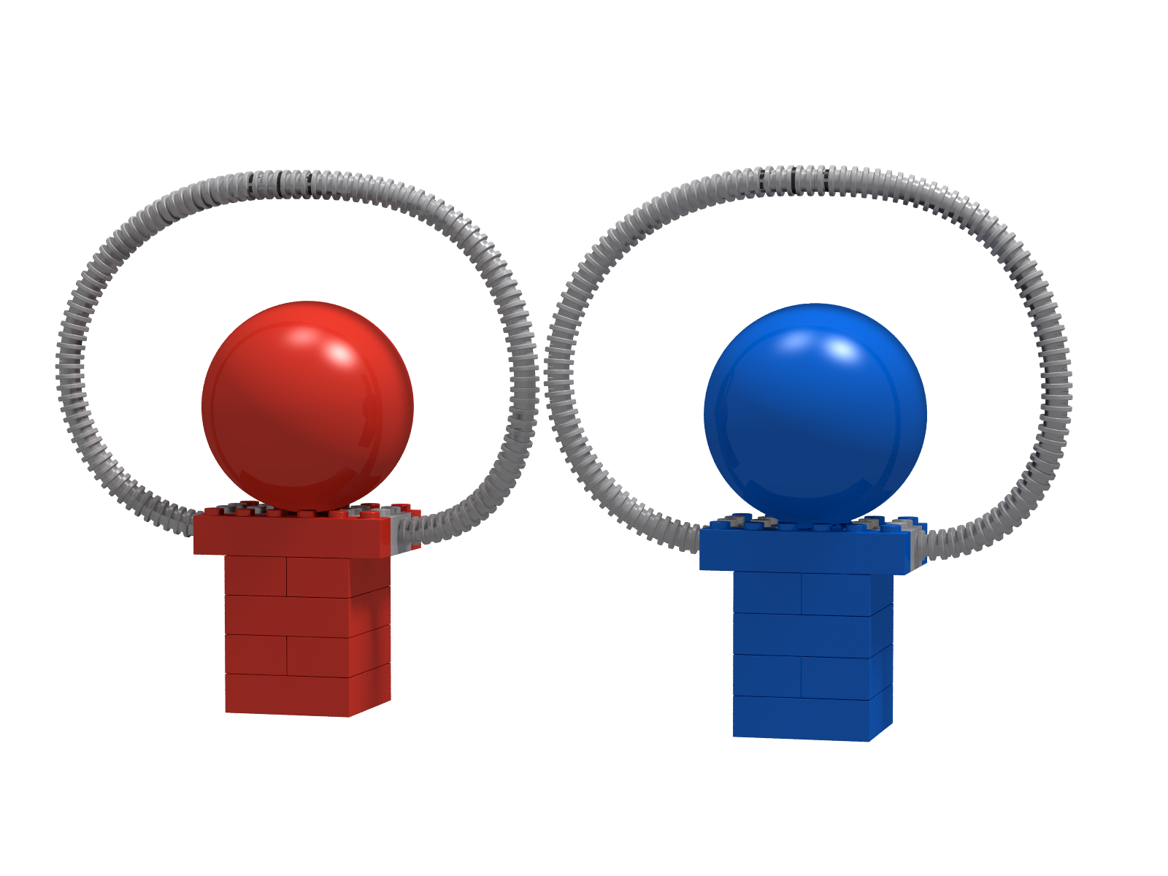
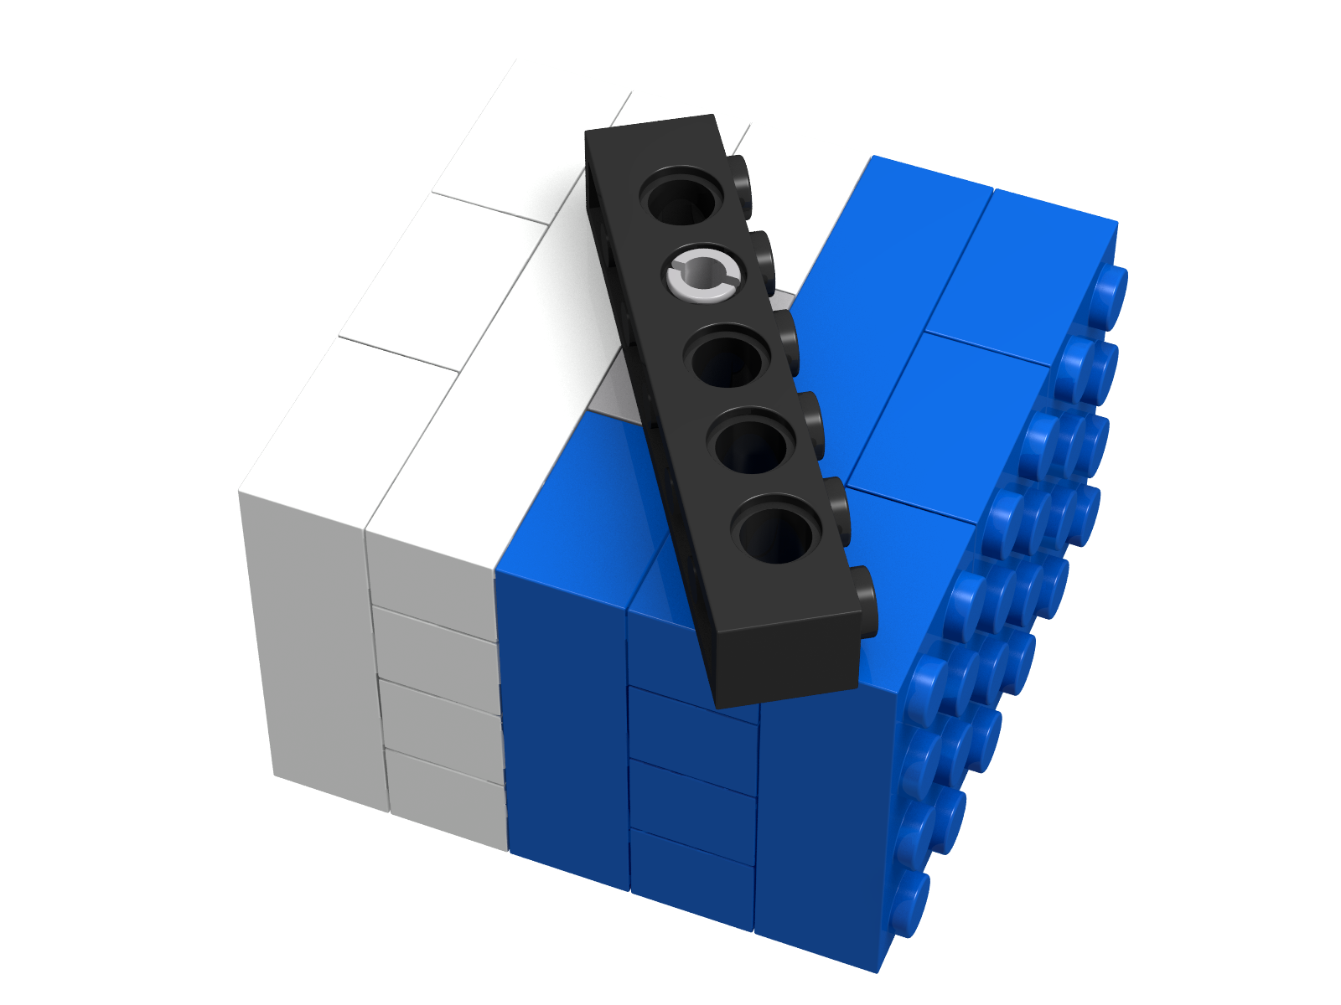
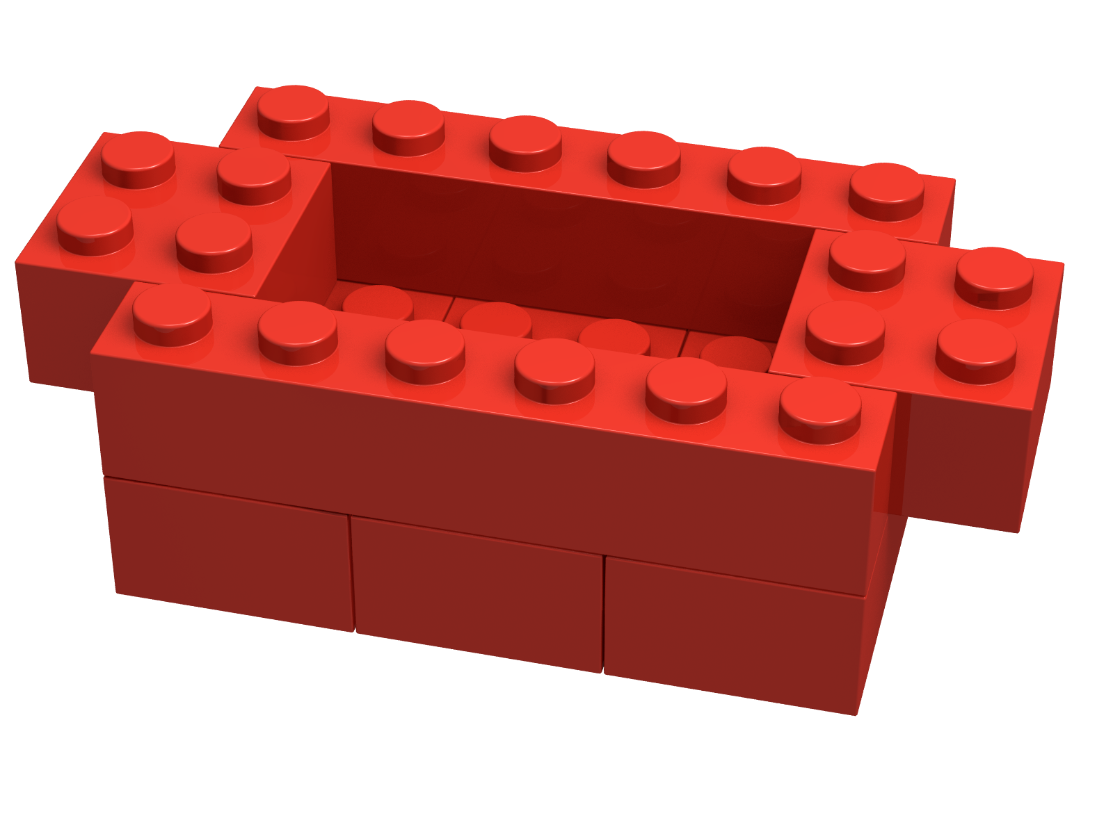

Slide 3


Slide 5
Complete the Pantheon
Bring the pillar to the SAFE PANTHEON AREA

Slide 6
Let the water in Shushtar flow
Move the gates off the water stream

Slide 7
Win the ball game in Chichen-Itza
Push the ball off its base

Slide 8
Win the ball game in Chichen-Itza
Only after both balls touch the game field: Bring the award in the SAFE CHICHEN-ITZA AREA

Slide 9
Bring the houseboat in Angkor Wat to its correct position
Bring the boat to the correct part of the lake, indicated by the randomizer

Slide 10
Bring the treasures from all corners to the Museum
Bring the four treasures to the Museum in the middle

Slide 11
Get bonus points
Don’t move the mills and goal rings of their positions

